Slide 1
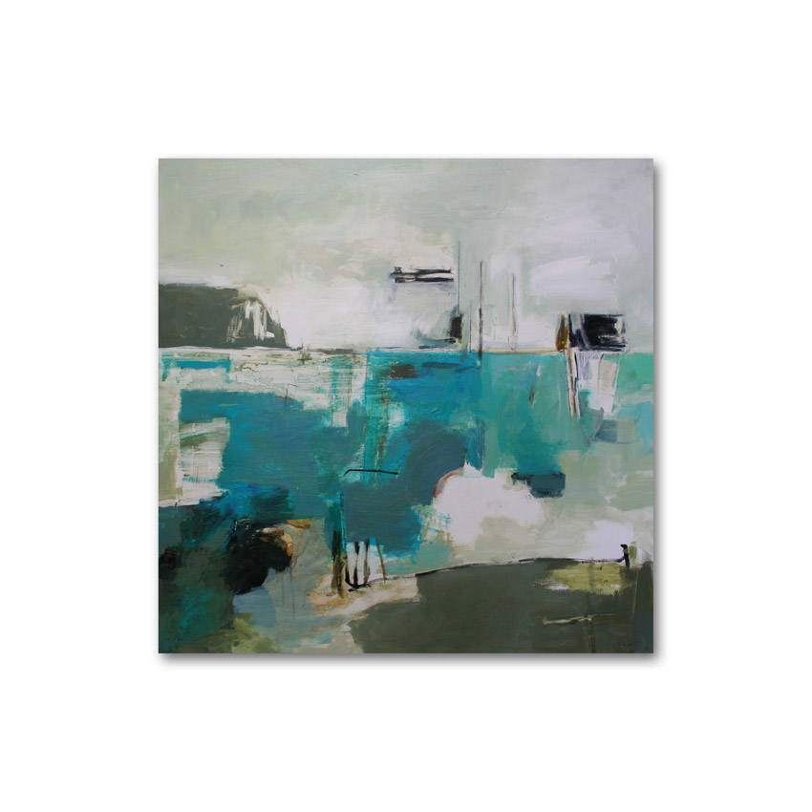
Bronwyn Abbott
Mercury lights
1000 X 1000mm

Slide 2
Bronwyn Abbott
Mercury lights
1000 X 1000mm

Slide 3
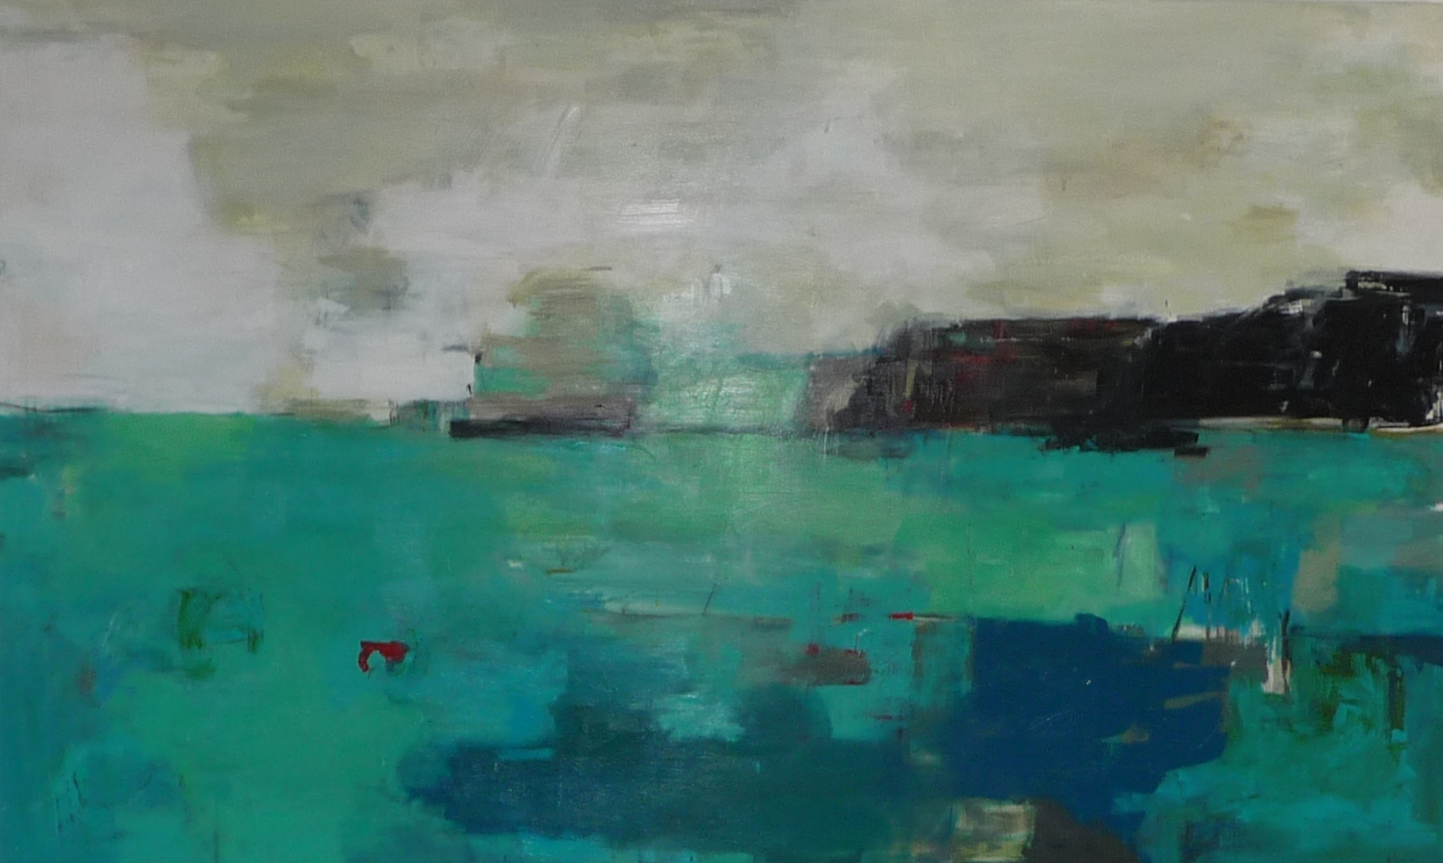
Bronwyn Abbott
Santorini meets the southern seas
1550 X 950mm

Slide 4
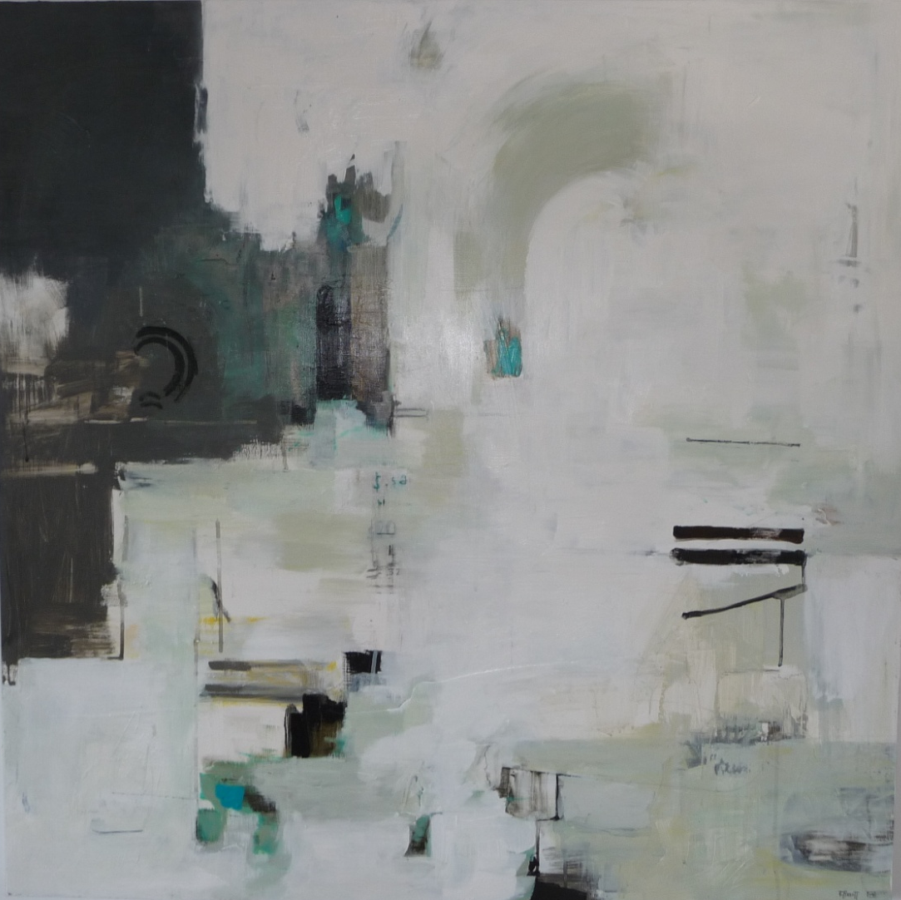
Bronwyn Abbott
Tunnel of light
1100 X 1100mm

Slide 5
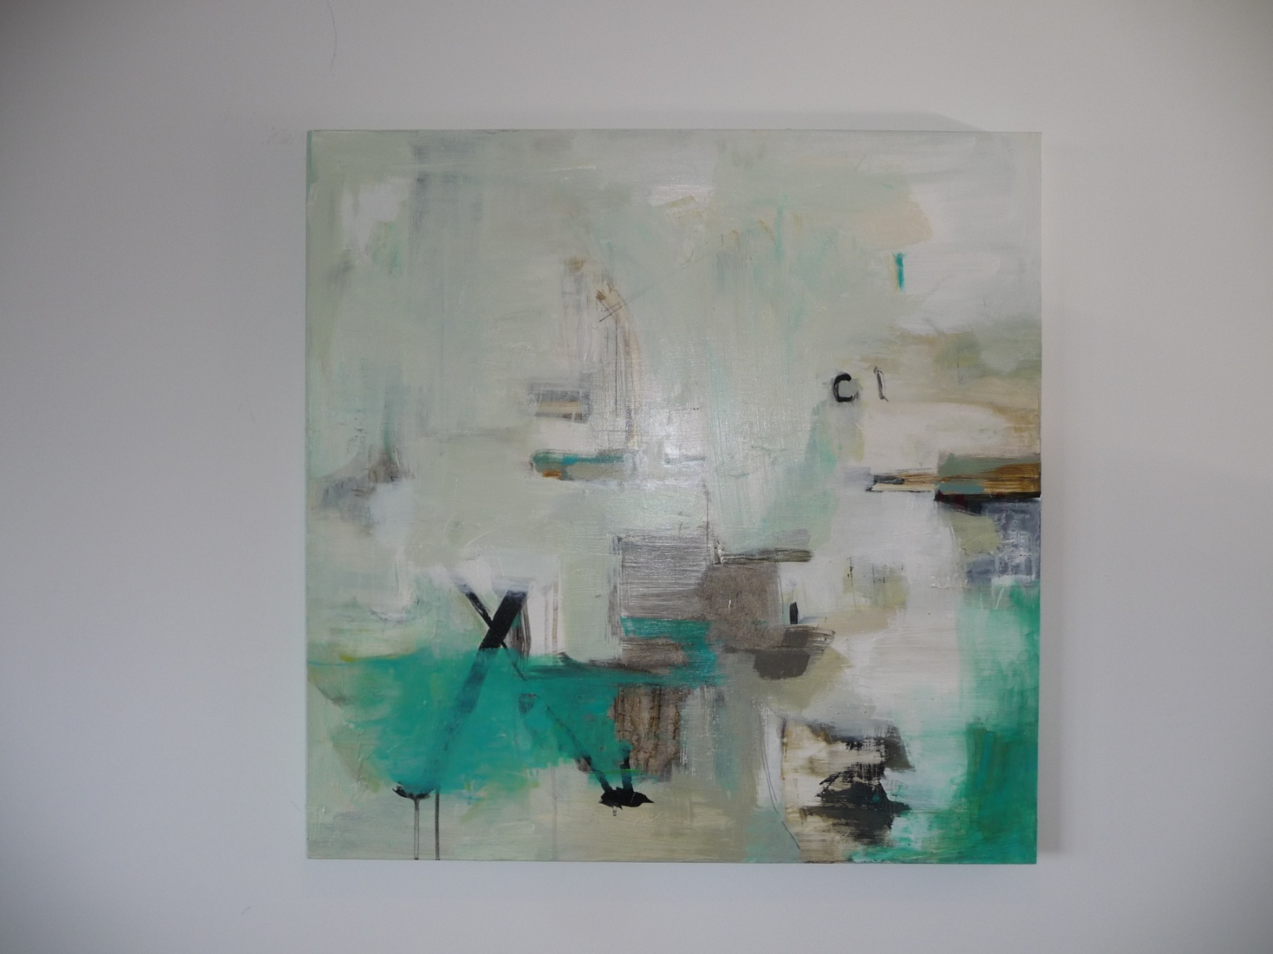
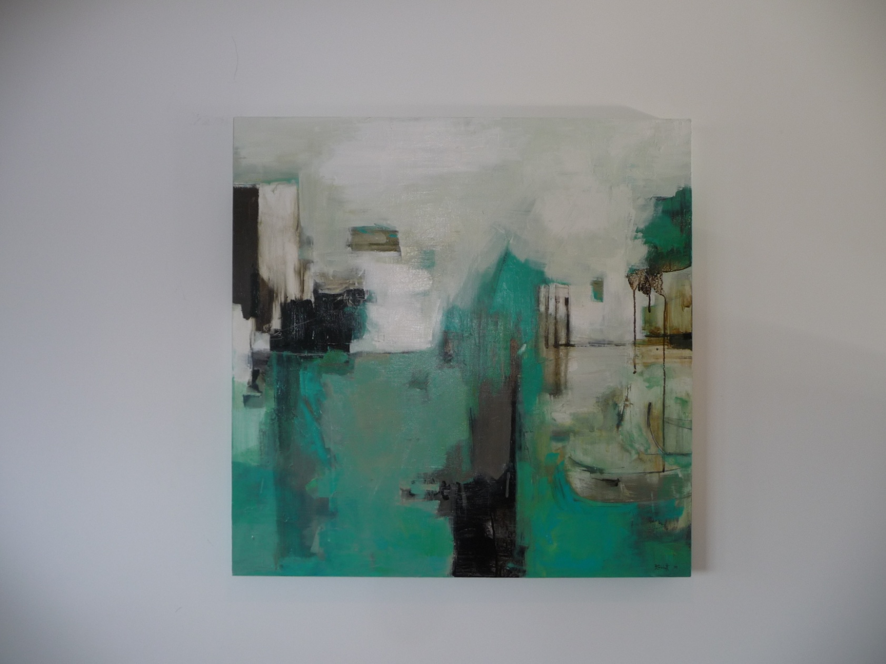
Bronwyn Abbott
Light of the lagoon ( pair )
800 X 1600 mm

Slide 6
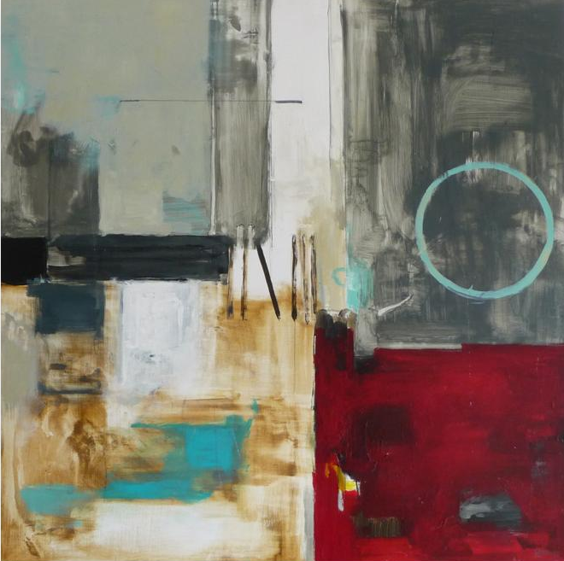
Bronwyn Abbott
Motu ( island within a reef )
800 X 800 mm
Not for sale

Slide 7
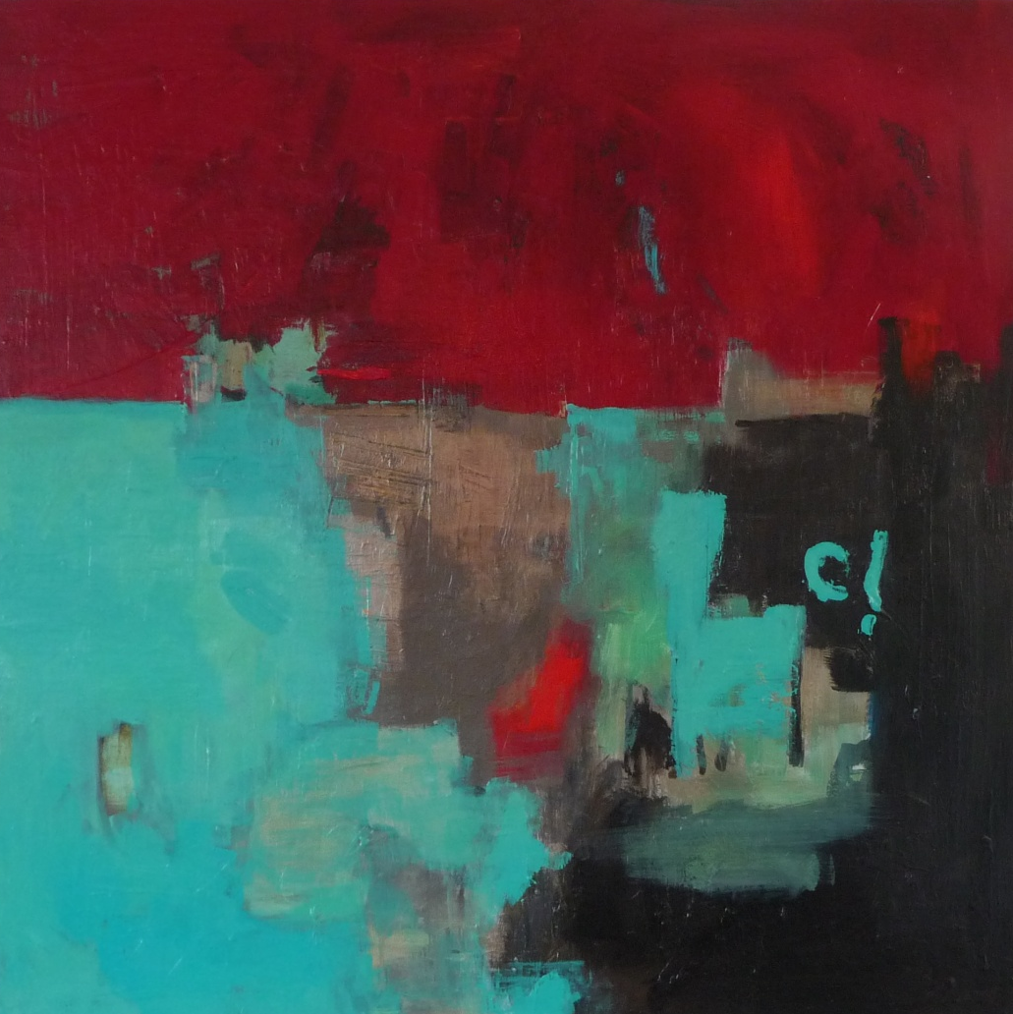
Bronwyn Abbott
Red Hot Spanish Skies
800 X 800mm

Slide 8
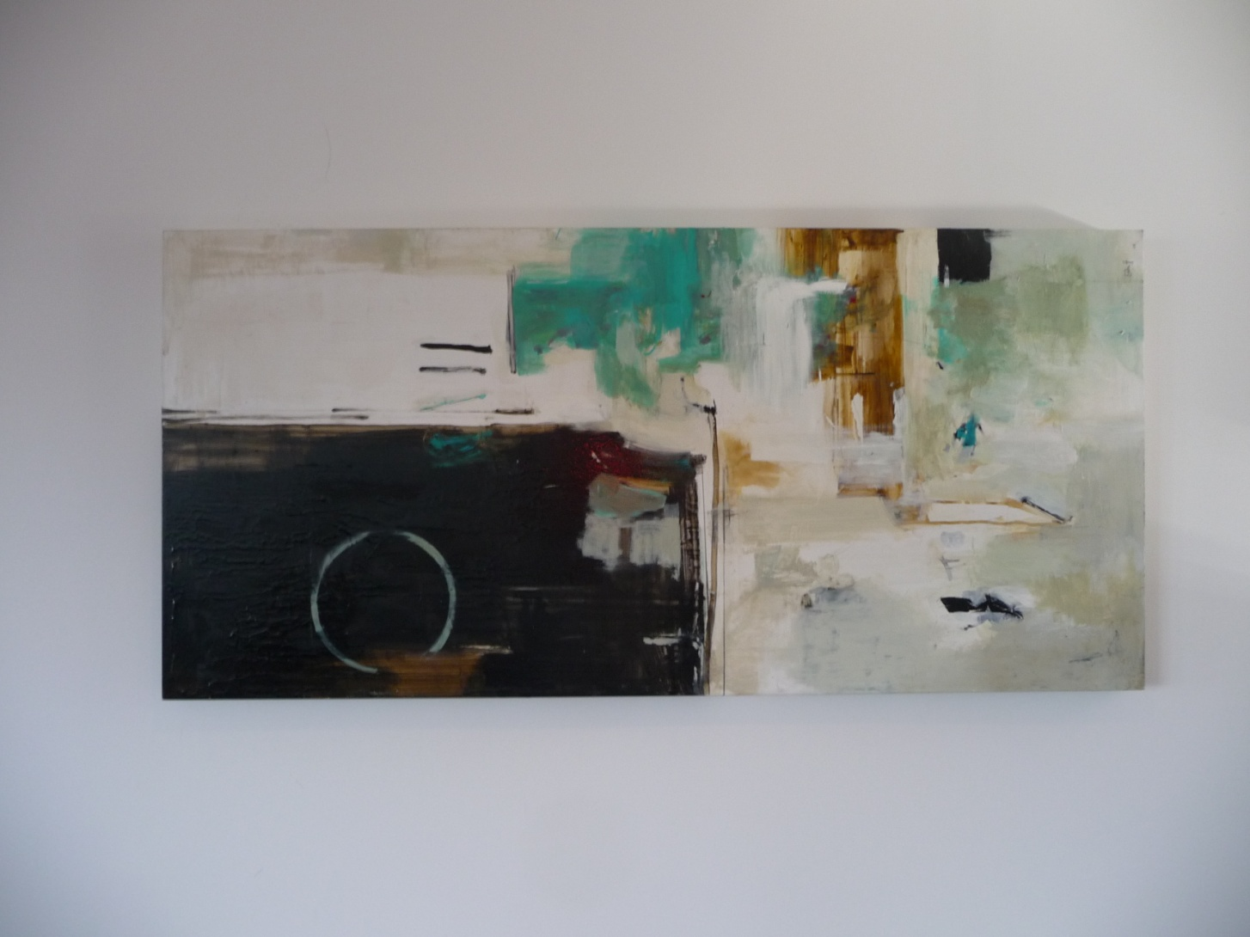

Bronwyn Abbott
Pacific nights
1300 X 600 mm

